Slide 1
Analysis of Climate Change Tweets

Slide 2
Introduction
Motivation
Find characteristic differences between climate change believers and deniers
Objective
Analyze climate change tweets from the past two years
Determine most pressing climate change issues, and identify trends by US region

Slide 3








Process
Tweet Classification
(Believers vs. Deniers)
Clustering
by Topics
Topic
Modeling

Slide 4
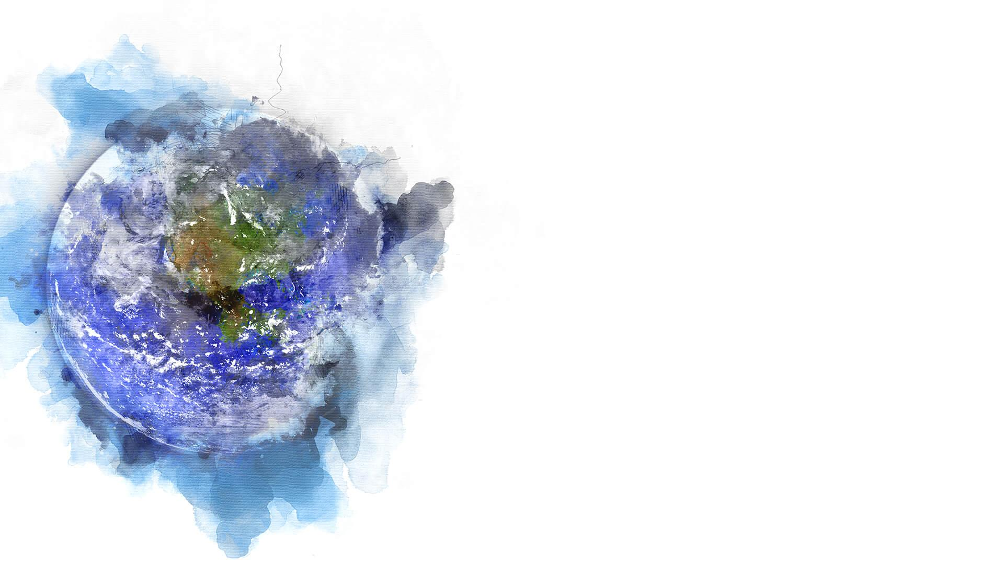
Dataset
Climate Change Tweets
20 million tweets from 2017 to 2019
Filtered from Twitter API by keywords/hashtags such as #climatechange, #globalwarming, #climatedeniers, #climatechangenotreal, etc.
Reduced to ~4 million tweets via MongoDB queries (e.g. no retweets)

Slide 5
Classification
Believers vs Deniers
Trained SVM model on subset of clearly biased tweets
contained hashtags such as #climatechangeisreal, #climatechangeisnotreal, etc.
Classified entire dataset with trained model (F1 score = 0.77)

Slide 6
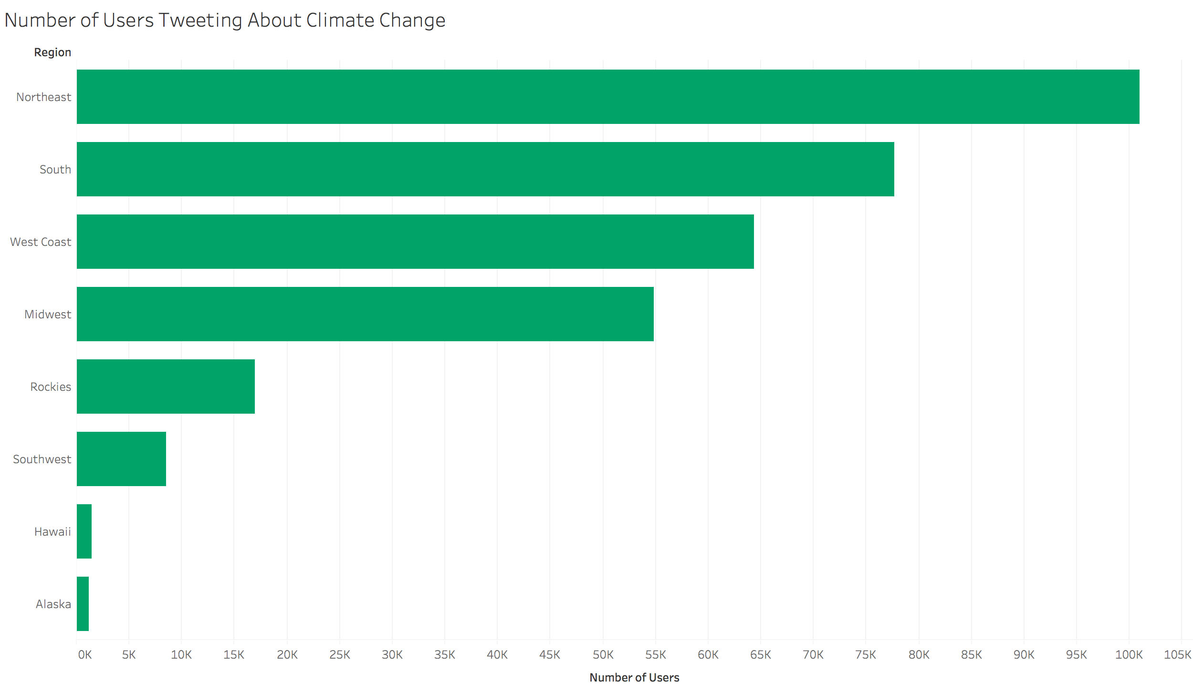
Exploratory Data Analysis

Slide 7
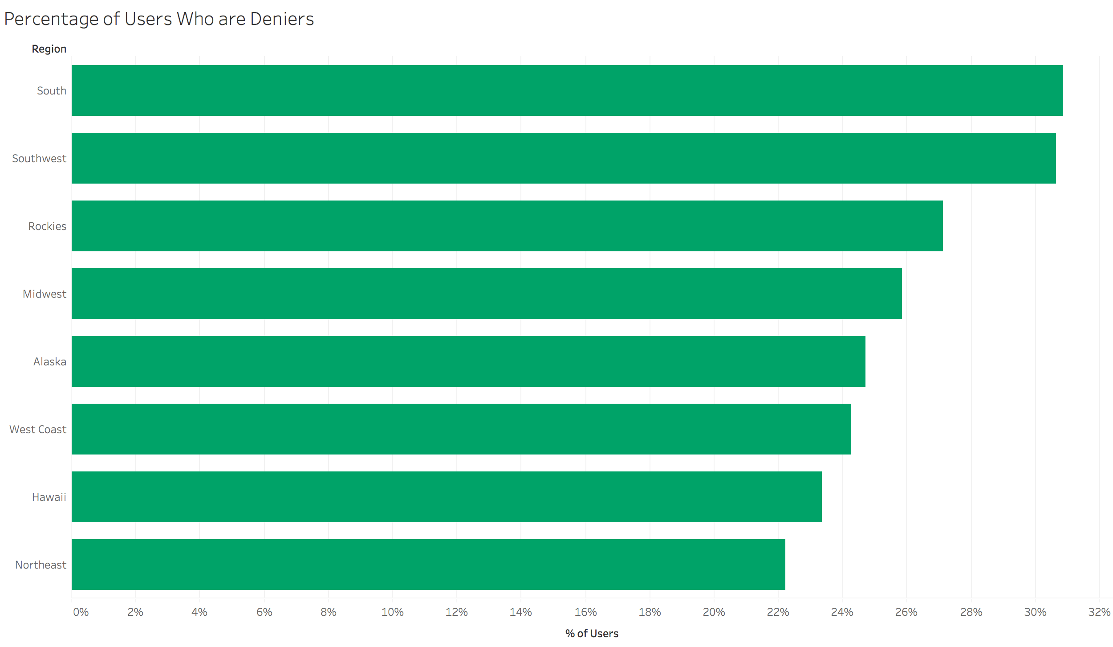
Exploratory Data Analysis

Slide 8
Exploratory Data Analysis

Slide 9
Exploratory Data Analysis

Slide 10
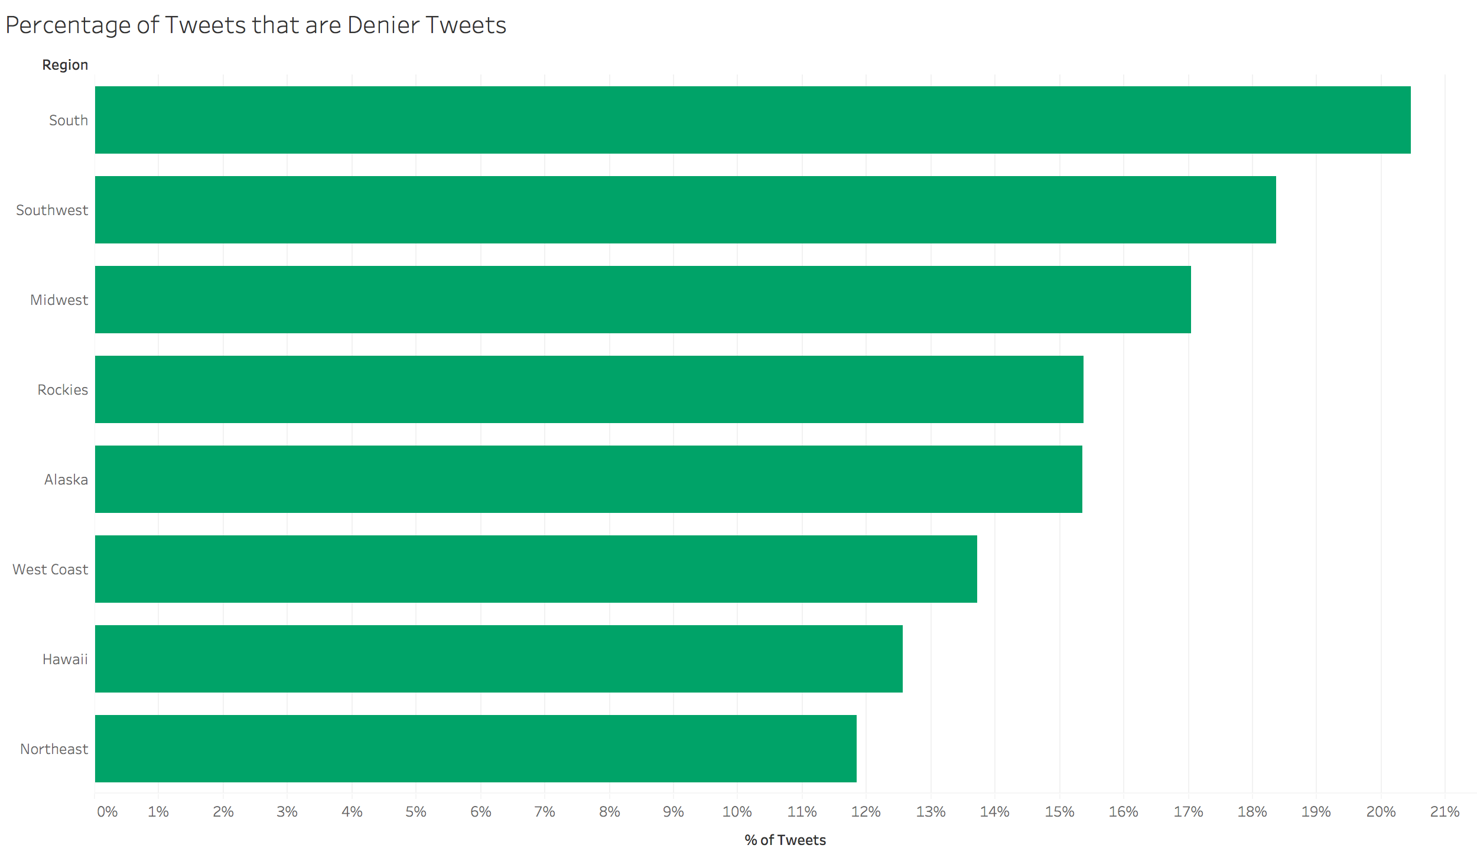
Exploratory Data Analysis

Slide 11
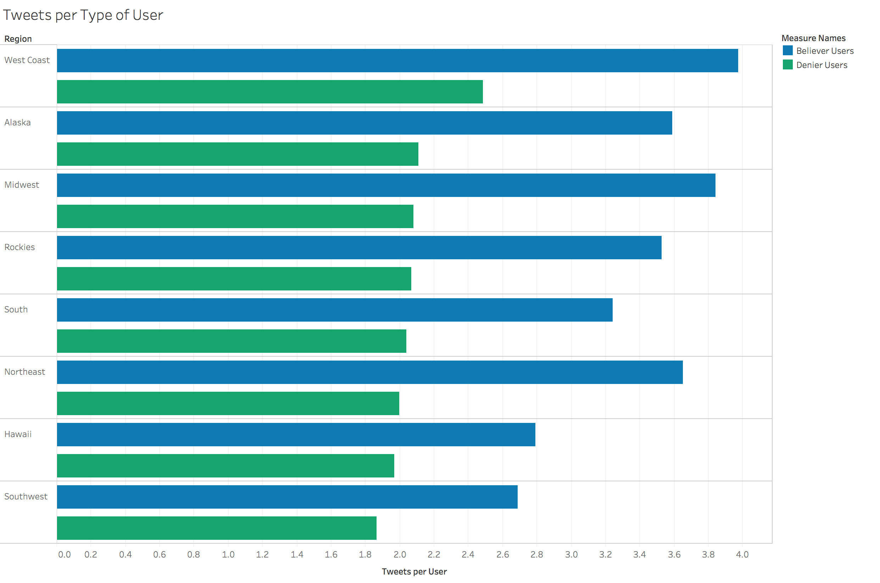
Exploratory Data Analysis

Slide 12
Topic Modeling
Dimensionality Reduction
Preprocessed tweets
Removed punctuation, url’s,
Reduced tweets to only nouns
Utilized NMF to reduce terms to 30 topics
Topics focused on major current events (often dictated by popular news publishers such as NY Times, Washington Post, etc.)

Slide 13
Topic Modeling
Concept | Topic
Popular Figures | Donald Trump, Scott Pruitt
Environmental Impact | Sea level rise, CO2 emissions, Animals at Risk
Sustainable Initiatives | Carbon Dividend Act, Auto Alliance, BlackRock Petition, Equator Banks Act

Slide 14
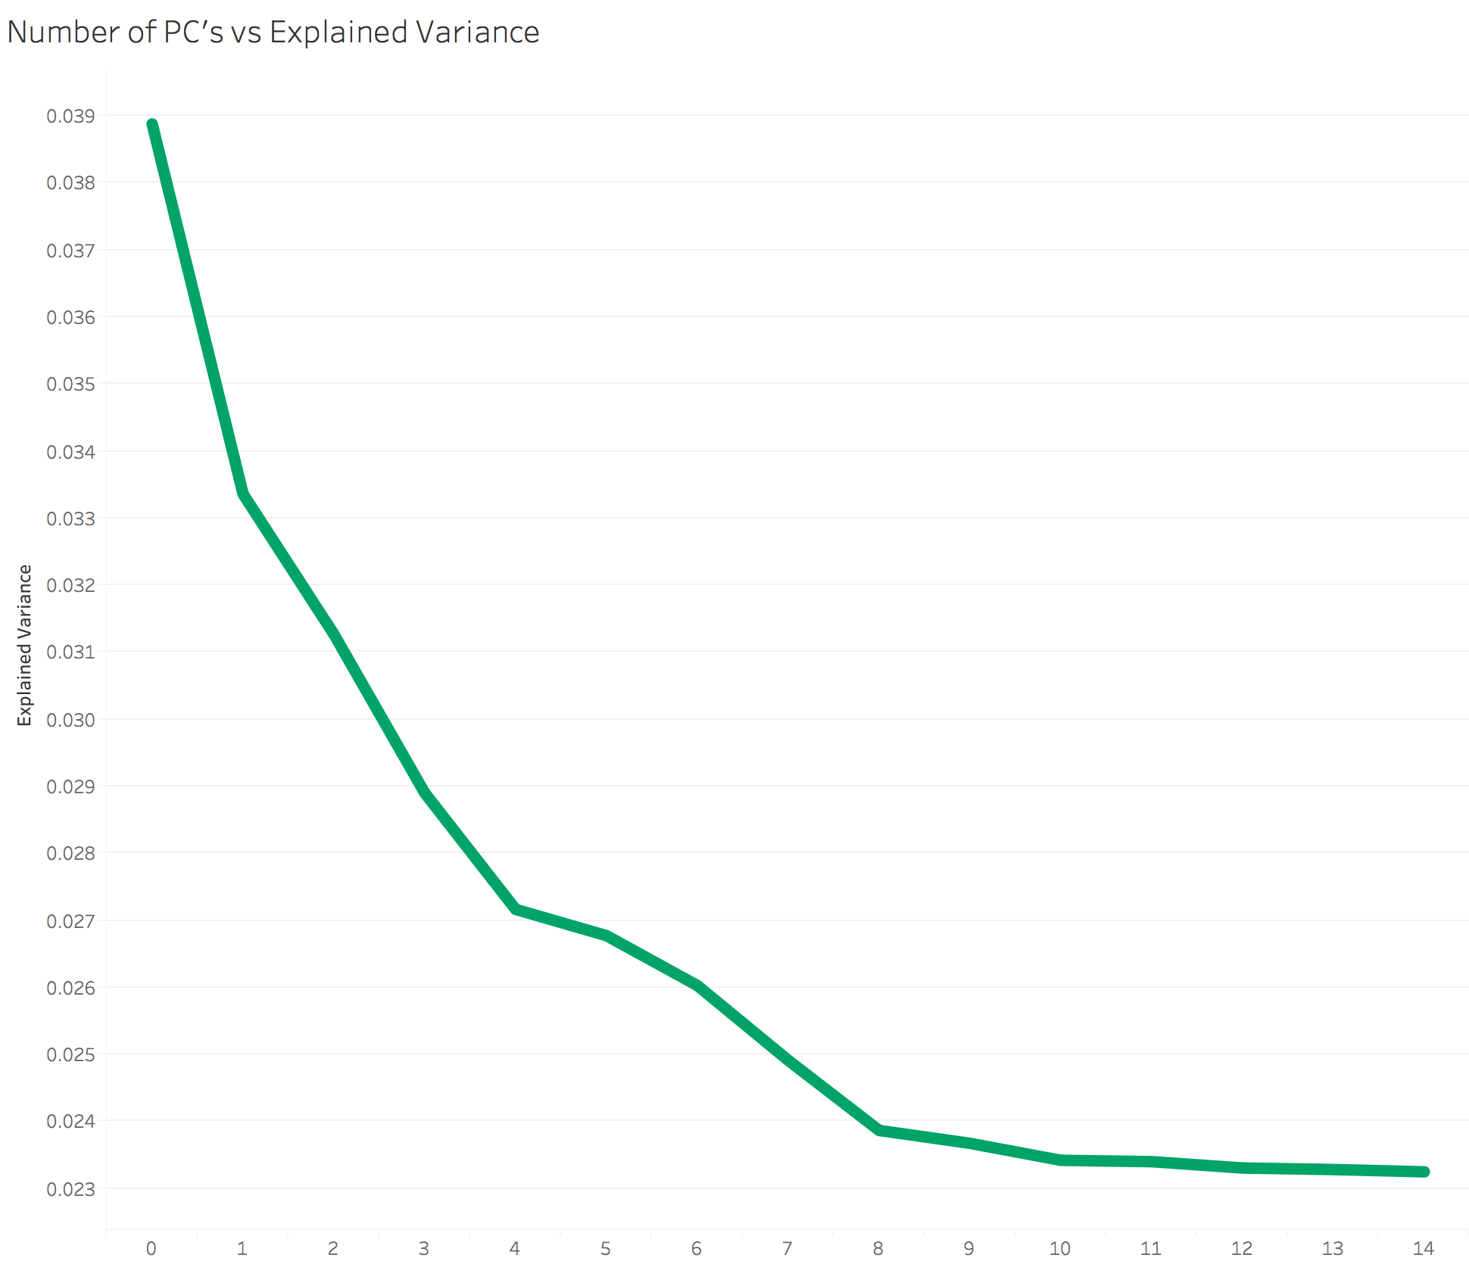
Dimensionality Reduction

Slide 15
Dimensionality Reduction
PC Components = 8

Slide 16
Clustering
K means clustering
Grouped data into 5 clusters based on inertia

Slide 17
Results
Cluster | Primary Region | % Deniers | Primary Sentiment | Primary Issues
1 | West Coast, Midwest, Rockies | 22% | Negative | Expense of climate change, climate change report from 2017
2 | South | 20% | Positive | Trump, coal and oil industries
3 | Northeast | 10% | Positive | Sustainability initiatives, effects of climate change (eg CO2 emissions)
4 | West Coast, Midwest, Rockies | 16% | Positive | Obama Era Policies, Al Gore

Slide 18
Results
Cluster 1
Objective
Analyze climate change tweets from the past two years
Determine most pressing climate change issues, and identify trends by US region

Slide 19
Dataset
Climate Change Tweets
20 million tweets from 2017 to 2019
Filtered from Twitter API by keywords/hashtags such as #climatechange, #globalwarming, #climatedeniers, #climatechangenotreal, etc.
Reduced to ~4 million tweets via MongoDB queries (e.g. no retweets)

Slide 20
Classification
Believers vs Deniers
Trained SVM model on subset of clearly biased tweets
contained hashtags such as “climatechangeisreal”, “climatechangeisnotreal”, etc.
Classified entire dataset with trained model (F1 score = 0.77)

Slide 21
Dataset
TfidfVectorizer will give you better performance than CountVectorizer as the size of the vocabulary increases
TfidfVectorizer would be better able to differentiate rare words and commonly
occurring words while Countvectorizer would still give equal weight to all words which is undesirable
NMF fixes values for the probability vectors of the multinomials, whereas LDA allows the topics and
words themselves to vary. Thus, in cases where we believe that the topic probabilities should remain
fixed per document (oftentimes unlikely)—or in small data settings in which the additional variability
coming from the hyperpriors is too much—NMF performs better.

Slide 22
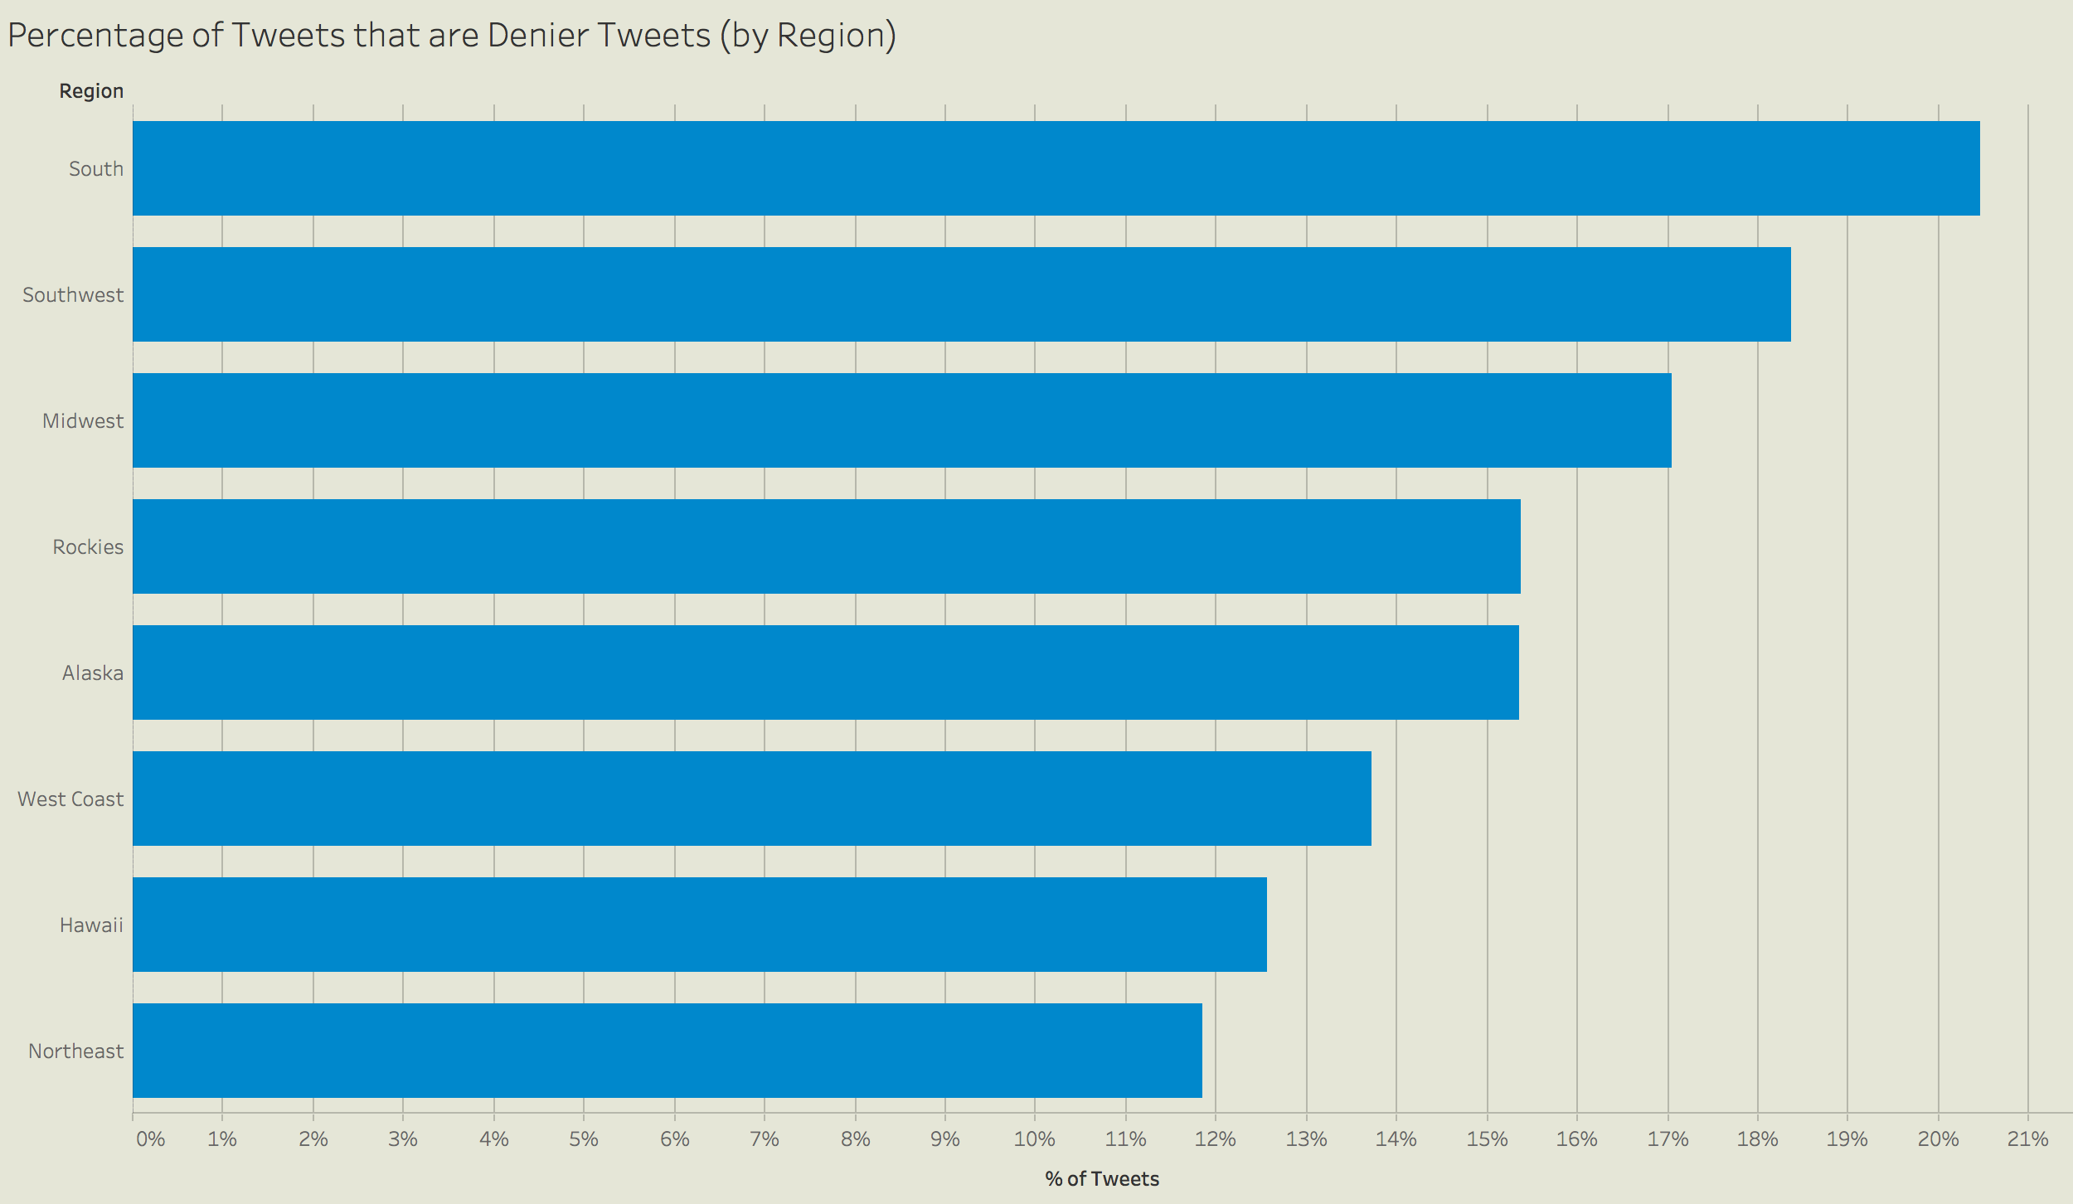
Exploratory Data Analysis

Slide 23
Questions?

Slide 24
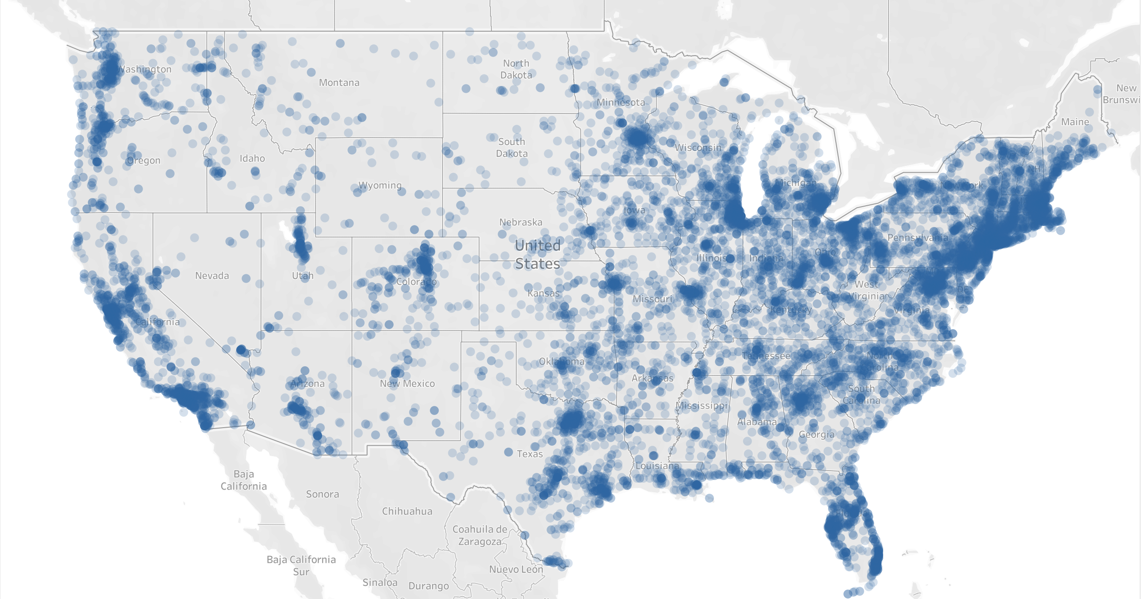
Appendix

Slide 25
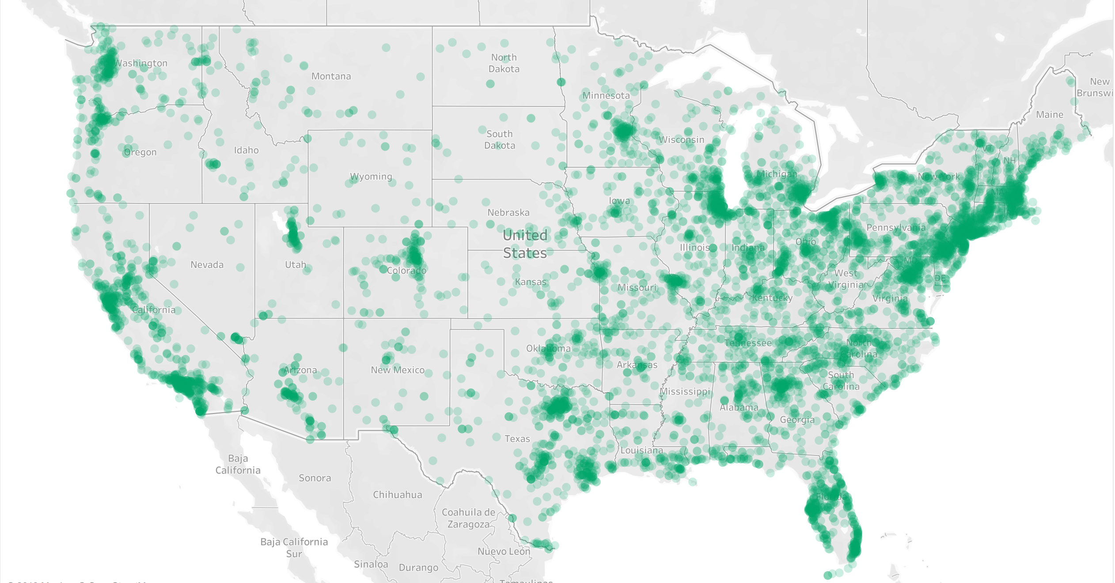
Appendix

Slide 26
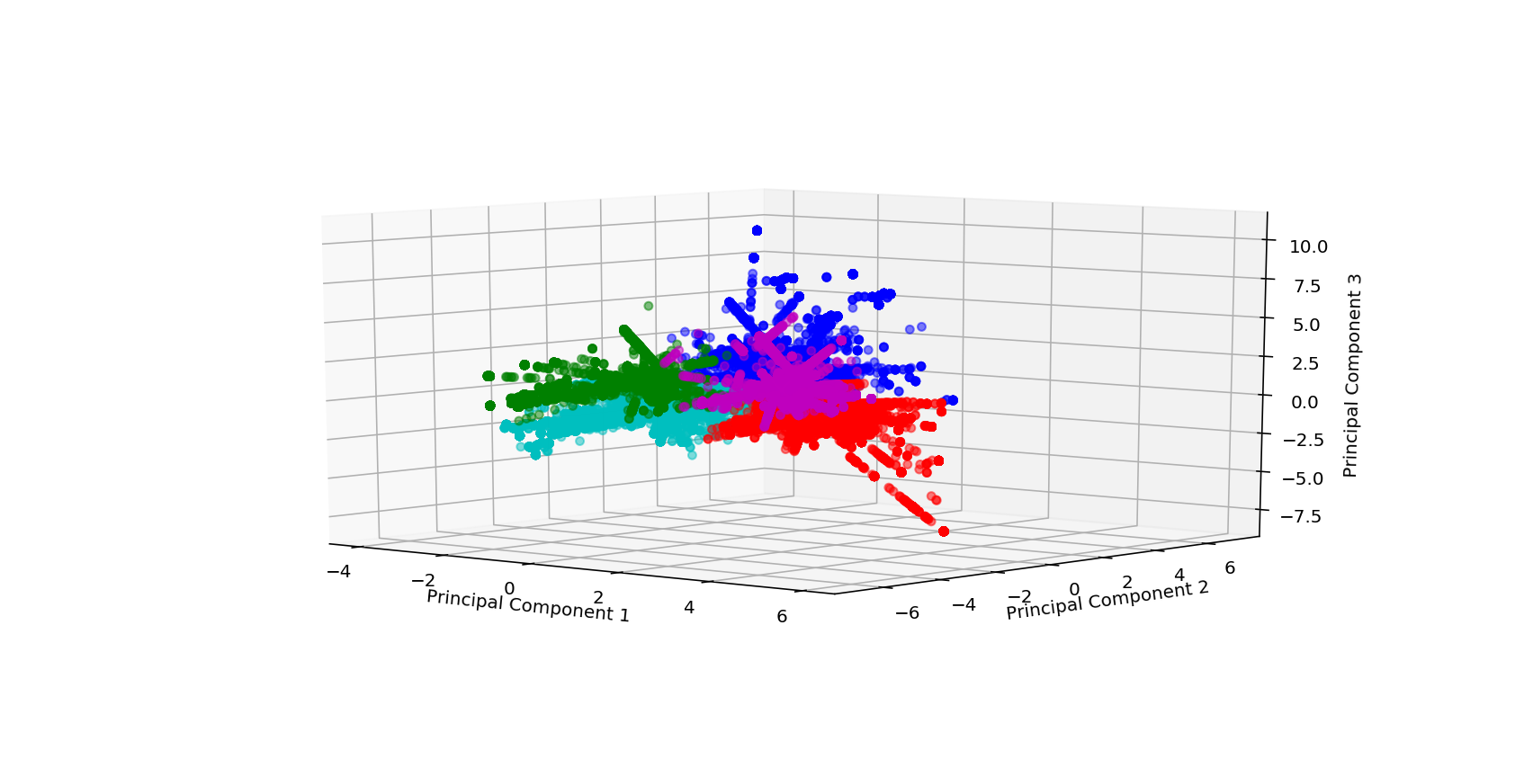
Clustering

Slide 27
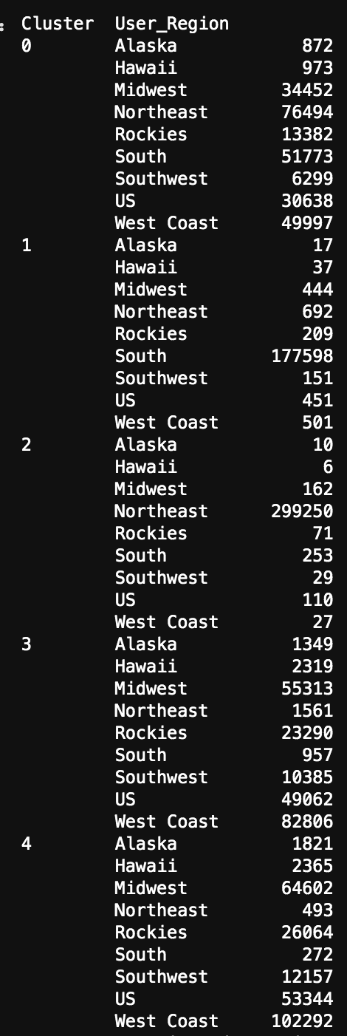
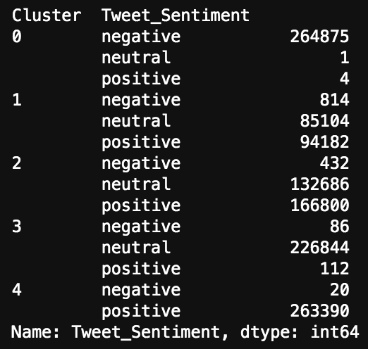
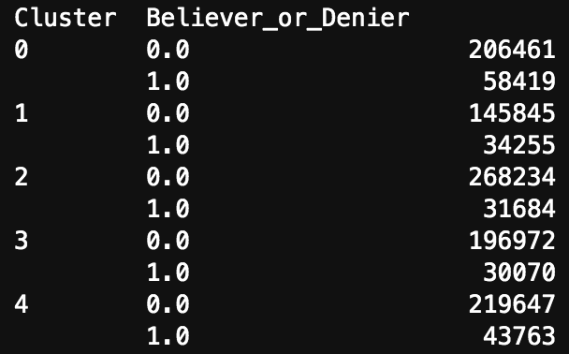
Appendix

Slide 28
Instructions for use
EDIT IN GOOGLE SLIDES
Click on the button under the presentation preview that says "Use as Google Slides Theme".
You will get a copy of this document on your Google Drive and will be able to edit, add or delete slides.
You have to be signed in to your Google account.
EDIT IN POWERPOINT®
Click on the button under the presentation preview that says "Download as PowerPoint template". You will get a .pptx file that you can edit in PowerPoint.
Remember to download and install the fonts used in this presentation (you’ll find the links to the font files needed in the Presentation design slide)
More info on how to use this template at www.slidescarnival.com/help-use-presentation-template
This template is free to use under Creative Commons Attribution license. You can keep the Credits slide or mention SlidesCarnival and other resources used in a slide footer.

Slide 29
Hello!
I am Jayden Smith
I am here because I love to give presentations.
You can find me at @username

Slide 30
This is a slide title
Here you have a list of items
And some text
But remember not to overload your slides with content
Your audience will listen to you or read the content, but won’t do both.

Slide 31
You can also split your content
White
Is the color of milk and fresh snow, the color produced by the combination of all the colors of the visible spectrum.
Black
Is the color of coal, ebony, and of outer space. It is the darkest color, the result of the absence of or complete absorption of light.

Slide 32
In two or three columns
Yellow
Is the color of gold, butter and ripe lemons. In the spectrum of visible light, yellow is found between green and orange.
Blue
Is the colour of the clear sky and the deep sea. It is located between violet and green on the optical spectrum.
Red
Is the color of blood, and because of this it has historically been associated with sacrifice, danger and courage.

Slide 33
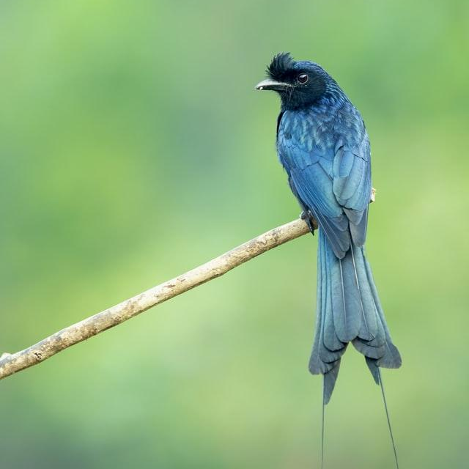
A picture is worth a thousand words
A complex idea can be conveyed with just a single still image, namely making it possible to absorb large amounts of data quickly.

Slide 34
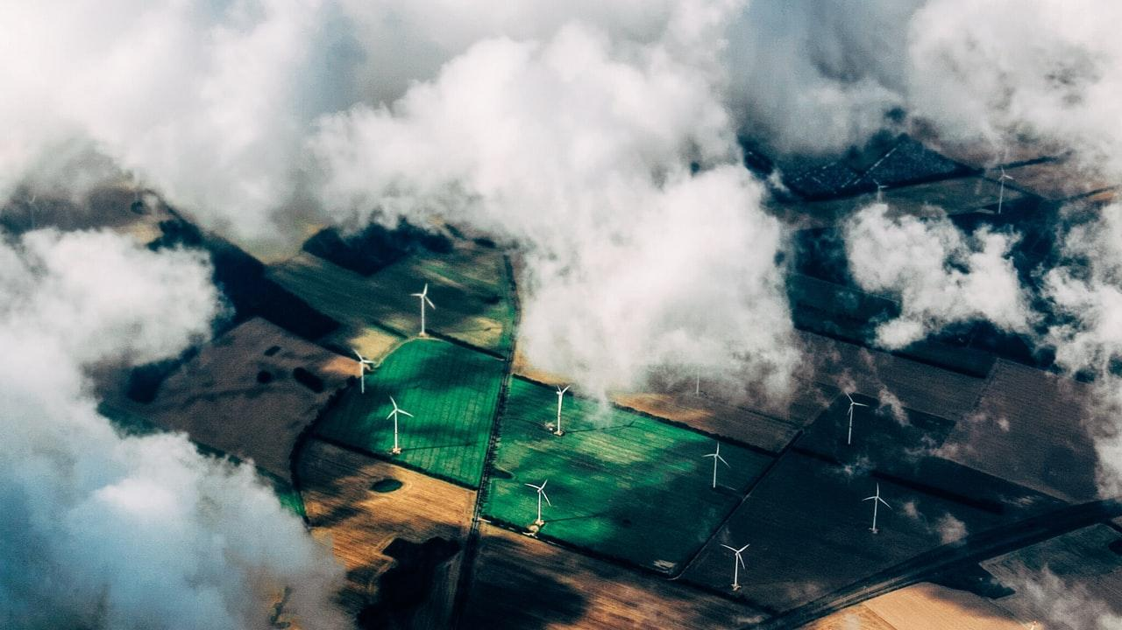
Want big impact?
Use big image.

Slide 35
Use diagrams to explain your ideas
Vestibulum congue
Vestibulum congue
Vestibulum congue

Slide 36
Place your screenshot here
Vestibulum congue
Vestibulum congue
Vestibulum congue

Slide 37

And tables to compare data
 | A | B | C
Yellow | 10 | 20 | 7
Blue | 30 | 15 | 10
Orange | 5 | 24 | 16

Slide 38
Maps
our office

Slide 39
89,526,124
Whoa! That’s a big number, aren’t you proud?

Slide 40

89,526,124$
185,244 users
100%
That’s a lot of money
And a lot of users
Total success!

Slide 41
Our process is easy
first
second
last

Slide 42
Let’s review some concepts
Yellow
Is the color of gold, butter and ripe lemons. In the spectrum of visible light, yellow is found between green and orange.
Blue
Is the colour of the clear sky and the deep sea. It is located between violet and green on the optical spectrum.
Red
Is the color of blood, and because of this it has historically been associated with sacrifice, danger and courage.
Yellow
Is the color of gold, butter and ripe lemons. In the spectrum of visible light, yellow is found between green and orange.
Blue
Is the colour of the clear sky and the deep sea. It is located between violet and green on the optical spectrum.
Red
Is the color of blood, and because of this it has historically been associated with sacrifice, danger and courage.

Slide 43
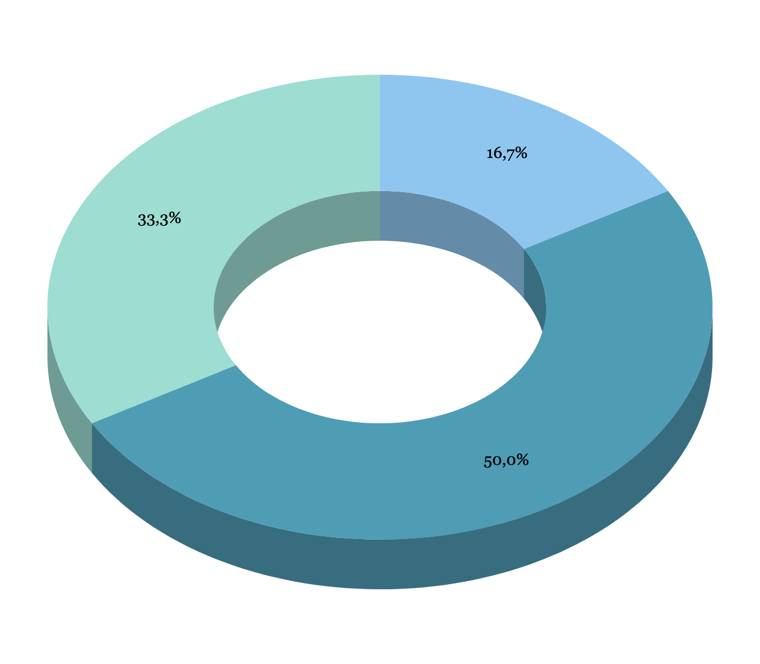
You can insert graphs from Google Sheets

Slide 44
Tablet project
Show and explain your web, app or software projects using these gadget templates.
Place your screenshot here

Slide 45
Desktop project
Show and explain your web, app or software projects using these gadget templates.
Place your screenshot here

Slide 46
Thanks!
Any questions?
You can find me at:
@username
user@mail.me

Slide 47
Credits
Special thanks to all the people who made and released these awesome resources for free:
Presentation template by SlidesCarnival
Photographs by Unsplash

Slide 48
Presentation design
This presentation uses the following typographies:
Titles: Kalam
Body copy: Merriweather
Download for free at:
https://www.fontsquirrel.com/fonts/kalam
https://www.fontsquirrel.com/fonts/merriweather
Download all the illustrated backgrounds here:
https://drive.google.com/file/d/1o22s-MVekIlxSb0Ldw_pcwMHDEnuUbT_/view?usp=sharing
You don’t need to keep this slide in your presentation. It’s only here to serve you as a design guide if you need to create new slides or download the fonts to edit the presentation in PowerPoint®

Slide 49
SlidesCarnival icons are editable shapes. This means that you can:
Resize them without losing quality.
Change fill color and opacity.
Change line color, width and style.
Isn’t that nice? :) Examples:

Slide 50
😉
You can also use any emoji as an icon! And of course it resizes without losing quality. How? Follow Google instructions https://twitter.com/googledocs/status/730087240156643328
✋👆👉👍👤👦👧👨👩👪💃🏃💑❤😂😉😋😒😭👶😸🐟🍒🍔💣📌📖🔨🎃🎈🎨🏈🏰🌏🔌🔑 and many more...

Slide 51

Free templates for all your presentation needs
For PowerPoint and Google Slides
100% free for personal or commercial use
Ready to use, professional and customizable
Blow your audience away with attractive visuals

